Slide 1
Operating System(22516) Unit 3 : Process Management Marks: 14
Prepared by:
Mrs. Kousar Ayub A.
Lecturer(Selection Grade)
Computer Engg. Dept
M. H. Saboo Siddik Polytechnic

Slide 2
Learning Outcomes
The learners will be able to:
Services of OS
System Calls
OS Components
Use of Operating System Tools

Slide 3
Process Management
Process: process state, process control block (PCB).
Process scheduling: Scheduling queues, Scheduler, context switch.
Inter-process Communication(IPC): Introduction, shared memory and message passing system.
Threads - Benefits, user and kernel threads, Multithreading Models - Many to one, one to one, many to many.
Execute Process commands like ps, wait, sleep, exit, kill

Slide 4
Process Concept
Process – a program in execution; process execution must progress in sequential fashion.
A process is a program in execution. Process is also called as job, task and unit of work.
A process is defined as, "an entity which represents the basic unit of work to be implemented in the system".
A process includes:
program counter
stack
data section

Slide 5
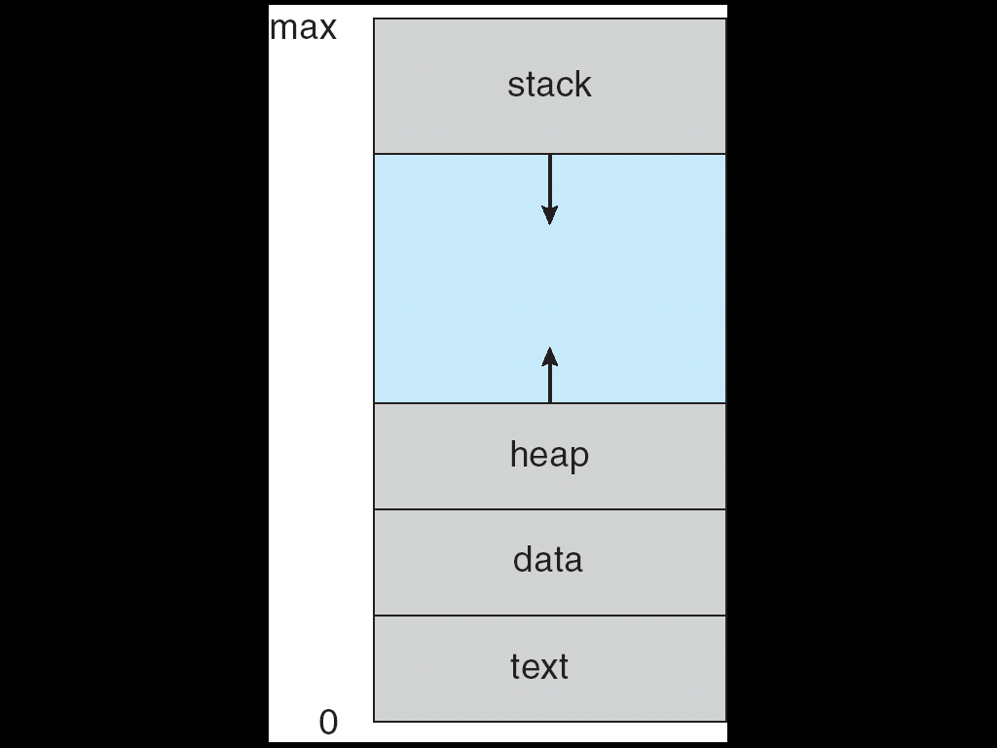
Process in Memory
Each process has following sections:
A Text section that contains the program code.
2. A Data section that contains global and static variables.
3. The heap is used for dynamic memory allocation, and is managed via calls to new, delete, malloc, free, etc.
4. The stack is used for local variables. A process stack which contains the temporary data (such as subroutine parameters, return addresses, and temporary variables). Space on the stack is reserved for local variables when they are declared (at function entrance or elsewhere, depending on the language), and the space is freed up when the variables go out of scope.
5. A program counter that contains the contents of processor’s registers

Slide 6
Process State
As a process executes, it changes state
new: The process is being created.
ready: The process is waiting to be assigned to a process.
running: Instructions are being executed.
waiting: The process is waiting for some event to occur.
terminated: The process has finished execution.

Slide 7
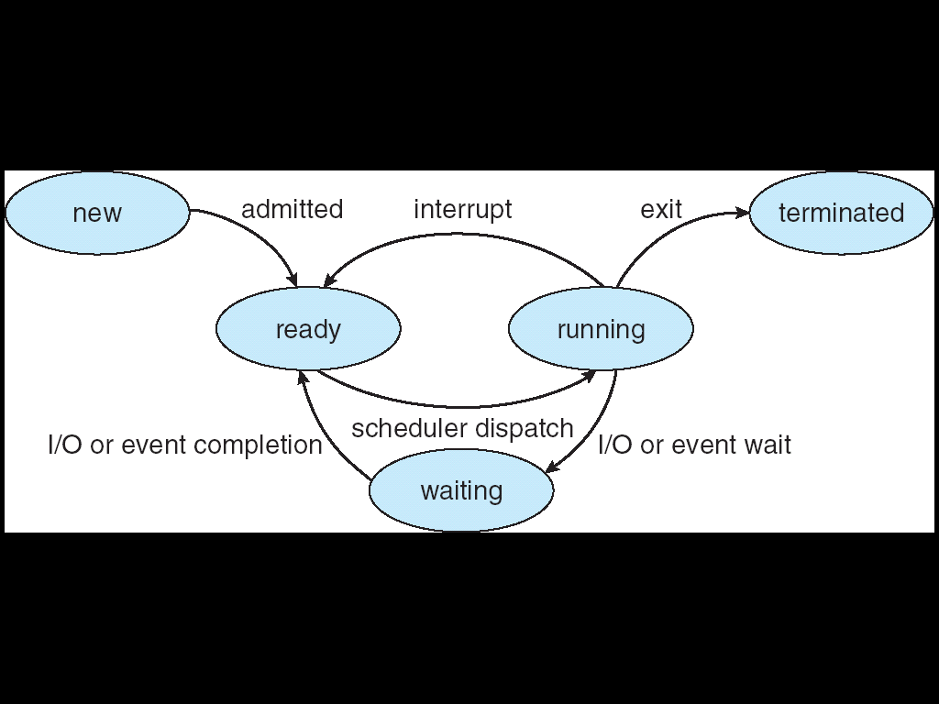
Diagram of Process State

Slide 8
Tables
Four different types of tables maintained by the operating system:
1. Memory Tables - are used to keep track of both main and secondary memory. Some of main memory is reserved for use by the operating system; the remainder is available for use by processes.
2. I/O Tables- are used by the operating systems to manage the I/O devices and channels of the computer system. At any given time, an I/O device may be available or assigned to a particular process.
3. File Tables -provide information about the existence of files, their location on secondary memory, their current status another attributes.
4. Process Tables- are used to manage processes a process must include a program or set of programs to be executed.

Slide 9
Process Control Block (PCB)
Each process is represented in the operating system by a Process Control Block (PCB) also called as Task Control Block (TCB).
When a process is created, operating system creates a corresponding PCB and released whenever the process terminates.
A PCB stores descriptive information pertaining to a process, such as its state, program counter, memory management information, information about its scheduling, allocated resources, accounting information, etc. that is required to control and manage a particular process.

Slide 10
Process Control Block (PCB)

Slide 11
Process Control Block (PCB)
1. Process Number: Each process is identified by its process number, called Process Identification Number (PID). Every process has a unique process-id through which it is identified. The process-id is provided by the OS. The process id of two processes could not be same because process-id is always unique.
2. Priority: Each process is assigned a certain level of priority that corresponds to the relative importance of the event that it services process priority is the preference of the one process over other process for execution. Priority may be given by the user/system manager or it may be given internally by OS. This field stores the priority of a particular process.
3. Process State: This information is about the current state of the process. The state may be new, ready, running, and waiting, halted, and so on.
4. Program Counter: The counter indicates the address of the next instruction to be executed for this process.

Slide 12
Process Control Block (PCB)
5. CPU Registers: The registers vary in number and type, depending on the computer architecture. They include accumulators, index registers, stack pointers, and general-purpose registers, plus any condition-code information. Along with the program counter, this state information must be saved when an interrupt occurs, to allow the process to be continued correctly afterward.
6. CPU Scheduling Information: This information includes a process priority, pointers to scheduling queues, and any other scheduling parameters.
7. Memory Management Information: This information may include such information as the value of the base and limit registers, the page tables, or the segment tables, depending on the memory system used by the operating system.

Slide 13
Process Control Block (PCB)
8. Accounting Information: This information includes the amount of CPU and real time used, time limits, account numbers, job or process numbers, and so on.
9. I/O Status Information: This information includes the list of I/O devices allocated to the process, a list of open files, and so on.
10. File Management: It includes information about all open files, access rights etc.
11. Pointer: Pointer points to another process control block. Pointer is used for maintaining the scheduling list.

Slide 14
Process Creation
When a new process is to be added to those currently being managed, the operating system builds the data structures that are used to manage the process and allocates address space in main memory to the process. This is the creation of a new process.
Parent process create children processes, which, in turn create other processes, forming a tree of processes
Resource sharing
Parent and children share all resources
Children share subset of parent’s resources
Parent and child share no resources
Execution
Parent and children execute concurrently
Parent waits until children terminate

Slide 15
Process Creation (Cont.)
Address space
Child duplicate of parent
Child has a program loaded into it
UNIX examples
fork system call creates new process
exec system call used after a fork to replace the process’ memory space with a new program
System call CreateProcess() in Windows and fork() in Unix which tells the operating system to create a new process.

Slide 16
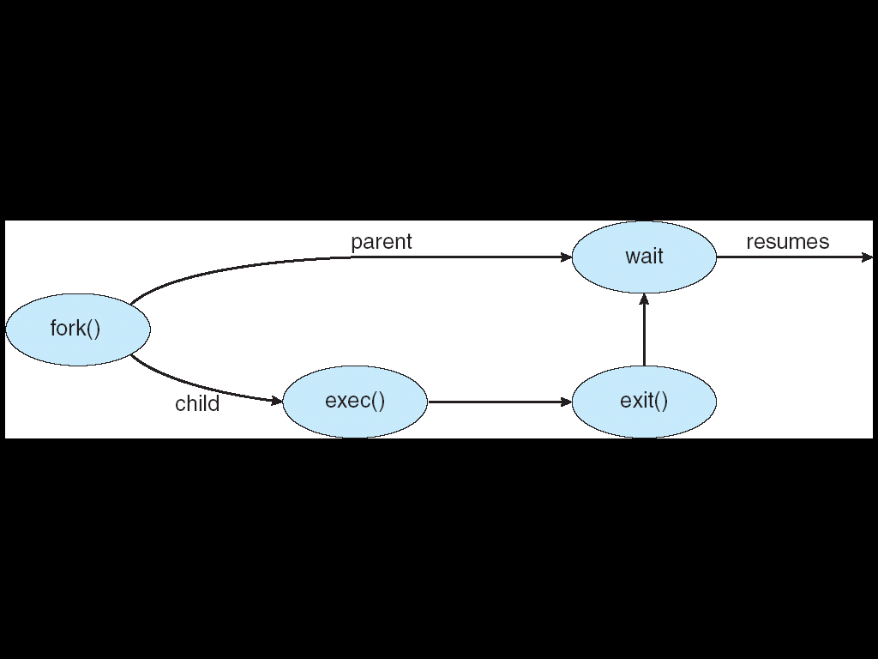
Process Creation

Slide 17
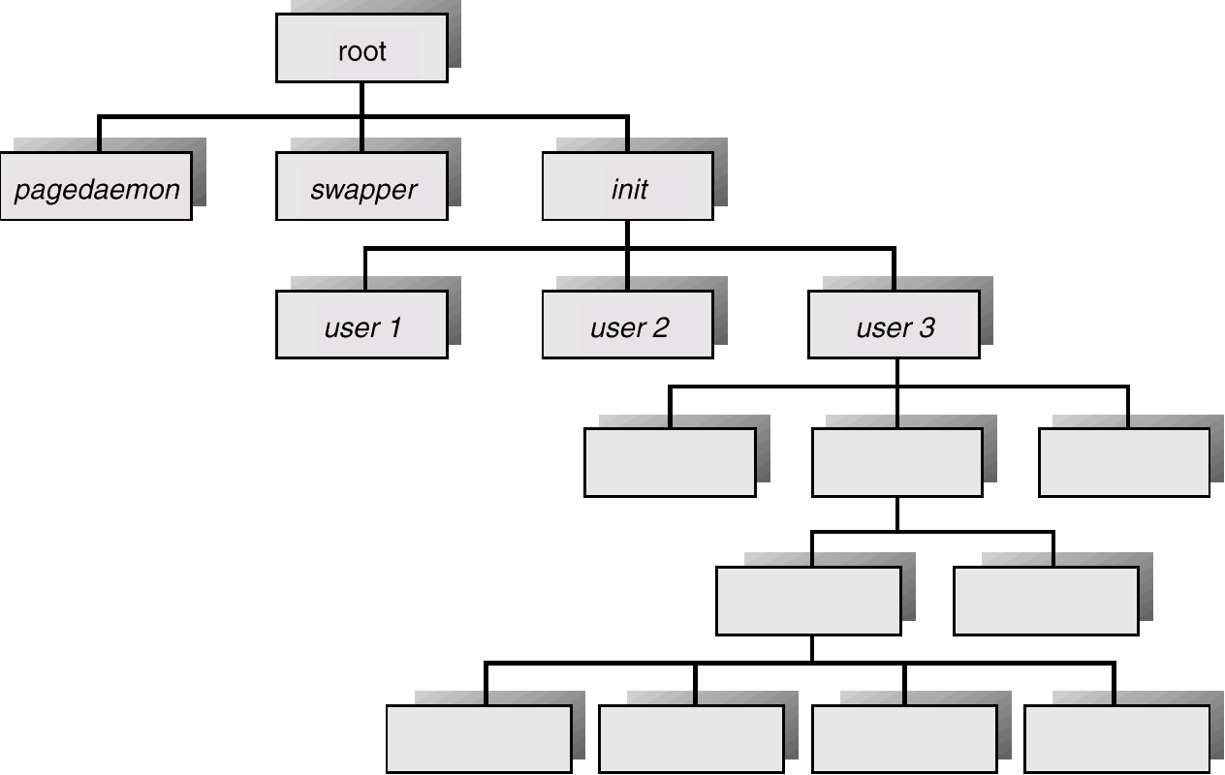
A Tree of Processes On A Typical UNIX System

Slide 18
Process Termination
Depending upon the condition, a process may be terminated either normally or forcibly by some another process.
Normal termination occurs when the process completes its task (operation) and invokes an appropriate system call ExitProcess( ) in Windows and exit( ) in Unix to tell the operating system that it is finished.
A process may cause abnormal termination of some another process. For this, the process invokes an appropriate system call TerminateProcess( ) in Windows and kill( ) in Unix that tells the operating system to kill some other process.

Slide 19
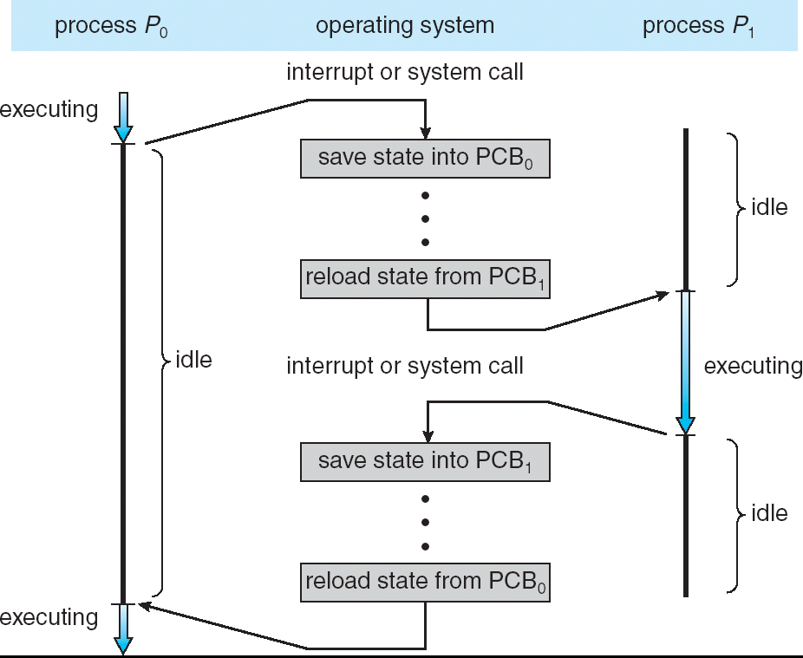
CPU Switch From Process to Process

Slide 20
Scheduling Queue
For a uniprocessor system, there will never be more than one running process. If there are more than one processes, the rest will have to wait until the CPU is free and can be rescheduled.
The processes, which are ready and waiting to execute, are kept on a list called the ready queue.
The list is generally a linked list. A ready queue header will contain pointers to the first and last PCB’s in the list. Each PCB has a pointer field which points to the next process in the ready queue.
There are also other queues in the system.
Job queue – set of all processes in the system
Ready queue – set of all processes residing in main memory, ready and waiting to execute
Device queues – set of
processes waiting for an I/O
device

Slide 21
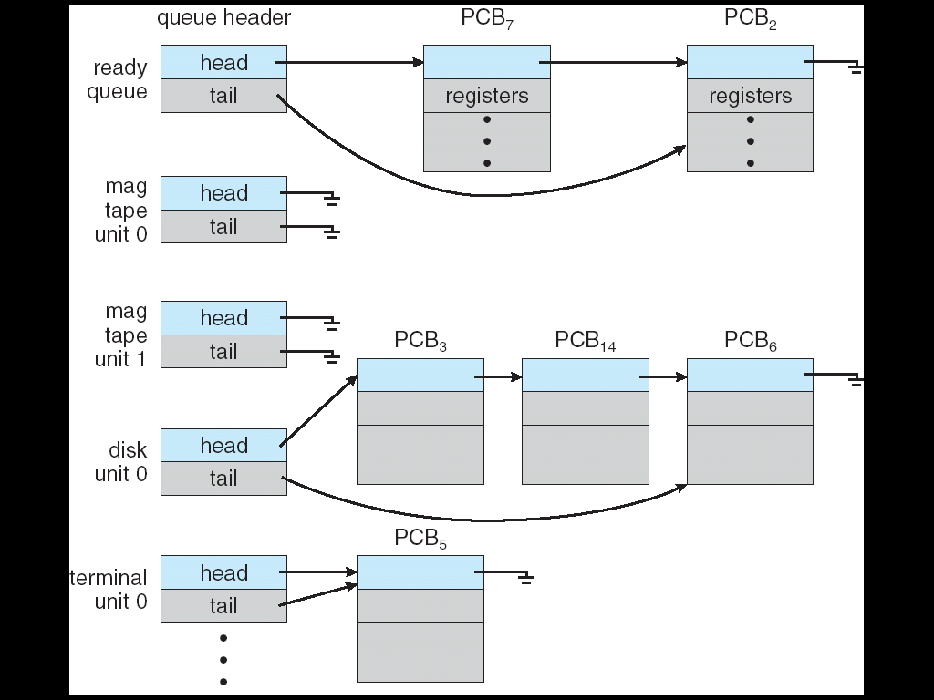
Ready Queue And Various I/O Device Queues

Slide 22
Queuing diagram representation of CPU Scheduling

Slide 23
Schedulers
Schedulers are special system software’s which handles process scheduling in various ways. Their main task is to select the jobs to be submitted into the system and to decide which process to run.
Schedulers are of three types namely, Long Term Scheduler, Short Term Scheduler and Medium Term Scheduler.
Long-term scheduler (or job scheduler) – selects which processes should be brought into the ready queue. Long term scheduler determines which programs are admitted to the system for processing. Job scheduler selects processes from the queue and loads them into memory for execution.
Medium Term Scheduler: On some systems, the long term scheduler may be absent or minimal.
Short-term scheduler (or CPU scheduler) – selects which process should be executed next and allocates CPU. The short term scheduler selects from memories, which are ready to execute and allocates the CPU to one of them. It is also called as CPU scheduler or process scheduler.

Slide 24
Working of Schedulers

Slide 25
Context Switch
When CPU switches to another process, the system must save the state of the old process and load the saved state for the new process. This task is known as a context switch.
CPU switching from one process to another process is called a context switch.
Context switch times are highly dependent on hardware support. Its speed varies from machine to machine, depending on the memory speed, the number of registers that must be copied and the existence of special instructions.
Context switch times are highly dependent on hardware support.

Slide 26
Context Switch

Slide 27
Interprocess Communication (IPC)
Interprocess communication (IPC) is a set of programming interfaces that allow a programmer to coordinate activities among different program processes that can run concurrently in an operating system.
The Interprocess Communication (IPC) is a set of techniques for the exchange of data among multiple processes.
IPC is required in all multiprocessing systems, but it is not generally supported by single-process operating systems such as DOS, OS/2 and MS-Windows etc.
IPC is particularly useful in a distributed environment where the communicating processes may reside on different computers connected with a network. For example, chat program used on the World Wide Web. IPC is best provided by a message passing system.

Slide 28
Models of inter Inter-process Communication (IPC)
Two fundamental models allows inter-process communication as explained below:
1. Shared Memory Model: Two processes exchange data or information through sharing region. They can read and write data from and to this region.
2. Message Passing Model: In message passing model the data or information is exchanged in the form of messages.

Slide 29
Communications Models

Slide 30
Message Passing
Message Passing:
In this model, communication takes place by exchanging messages between cooperating processes. It allows processes to communicate and synchronize their action without sharing the same address space. It is particularly useful in a distributed environment when communication process may reside on a different computer connected by a network. Communication requires sending and receiving messages through the kernel. The processes that want to communicate with each other must have a communication link between them. Between each pair of processes exactly one communication link.

Slide 31
Shared Memory
Shared memory:
In this a region of the memory residing in an address space of a process creating a shared memory segment can be accessed by all processes who want to communicate with other processes. All the processes using the shared memory segment should attach to the address space of the shared memory. All the processes can exchange information by reading and/or writing data in shared memory segment. The form of data and location are determined by these processes who want to communicate with each other. These processes are not under the control of the operating system. The processes are also responsible for ensuring that they are not writing to the same location simultaneously. After establishing shared memory segment, all accesses to the shared memory segment are treated as routine memory access and without assistance of kernel.

Slide 32
Direct Communication
Processes that want to communicate must have a way to refer to each other. They can use either direct or indirect communication.
With direct communication, each process that wants to communicate must explicitly name the recipient or sender of the communication.
(i) send (A, message): Send a message to process A.
(ii) receive (B, message): Receive a message from process B.
Properties of Direct communication:
A link is established automatically between every pair of processes that want to communicate. The processes need to know only each other's identity to communicate.
A link is associated with exactly two processes.
Exactly one link exists between each pair of processes.

Slide 33
Indirect Communication
With indirect communication, the message is sent to and receives from mailboxes or ports.
Mailbox where messages can be placed by processes and from which messages can be removed.
Each mailbox has a unique identification. Two processes can communicate only if they share a mailbox. The send and receive primitives are defined as follows:
(i) send (A, message): Send a message to mailbox A.
(ii) receive (A, message): Receive a message from mailbox A.
Properties of Indirect Communication
A link is established between a pair of processes only if both members of the pair have a shared mailbox.
A link may be associated with more than two processes.
Between each pair of communicating processes, there may be a number of different links, with each link corresponding to one mailbox.

Slide 34
Synchronization
Message passing may be either blocking or non-blocking
Blocking is considered synchronous
Blocking send has the sender block until the message is received
Blocking receive has the receiver block until a message is available
Non-blocking is considered asynchronous
Non-blocking send has the sender send the message and continue
Non-blocking receive has the receiver receive a valid message or null

Slide 35
Buffering
Queue of messages attached to the link; implemented in one of three ways
1. Zero capacity – 0 messages Sender must wait for receiver
2. Bounded capacity – finite length of n messages Sender must wait if link full
3. Unbounded capacity – infinite length Sender never waits

Slide 36
Critical Section Problem
Each process contains two sections. One is critical section where a process may need to access common variable or objects and other is remaining section containing instructions for processing of sharable objects or local objects of the process. Each process must request for permission to enter inside its critical section. The section of code implementing this request is the entry section. In entry section if a process gets permission to enter into the critical section then it works with common data. At this time all other processes are in waiting state for the same data.
The critical section is followed by an exit section. Once the process completes its task, it releases the common data in exit section. Then the remaining code placed in the remainder section is executed by the process.
Two processes cannot execute their critical sections at the same time. The critical section problem is to design a protocol that the processes can use to cooperate i.e. allowing entry to only one process at a time inside the critical section. Before entering into the critical section each process must request for permission to entry inside critical section.

Slide 37
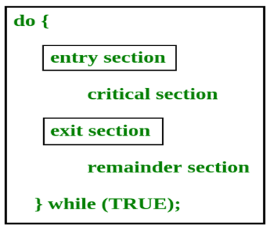
Critical Section problem

Slide 38
Thank you…..
You can mail your Queries to :
a2kousarj@gmail.com

Slide 39
Thank you…..
You can mail your Queries to :
a2kousarj@gmail.com

Slide 40
Thank you…..
You can mail your Queries to :
a2kousarj@gmail.com

Slide 41
Thank you…..
You can mail your Queries to :
a2kousarj@gmail.com

Slide 42
Thank you…..
You can mail your Queries to :
a2kousarj@gmail.com

Slide 43
Thank you…..
You can mail your Queries to :
a2kousarj@gmail.com

Slide 44
Thank you…..
You can mail your Queries to :
a2kousarj@gmail.com

Slide 45
Thank you…..
You can mail your Queries to :
a2kousarj@gmail.com

Slide 46
Thank you…..
You can mail your Queries to :
a2kousarj@gmail.com

Slide 47
Thank you…..
You can mail your Queries to :
a2kousarj@gmail.com

Slide 48
Thank you…..
You can mail your Queries to :
a2kousarj@gmail.com

Slide 49
Thank you…..
You can mail your Queries to :
a2kousarj@gmail.com

Slide 50
Thank you…..
You can mail your Queries to :
a2kousarj@gmail.com

Slide 51
Thank you…..
You can mail your Queries to :
a2kousarj@gmail.com

Slide 52
Thank you…..
You can mail your Queries to :
a2kousarj@gmail.com

Slide 53
Thank you…..
You can mail your Queries to :
a2kousarj@gmail.com

Slide 54
Thank you…..
You can mail your Queries to :
a2kousarj@gmail.com

Slide 55
Thank you…..
You can mail your Queries to :
a2kousarj@gmail.com

Slide 56
Thank you…..
You can mail your Queries to :
a2kousarj@gmail.com

Slide 57
Thank you…..
You can mail your Queries to :
a2kousarj@gmail.com

